Slide 1
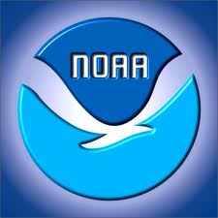
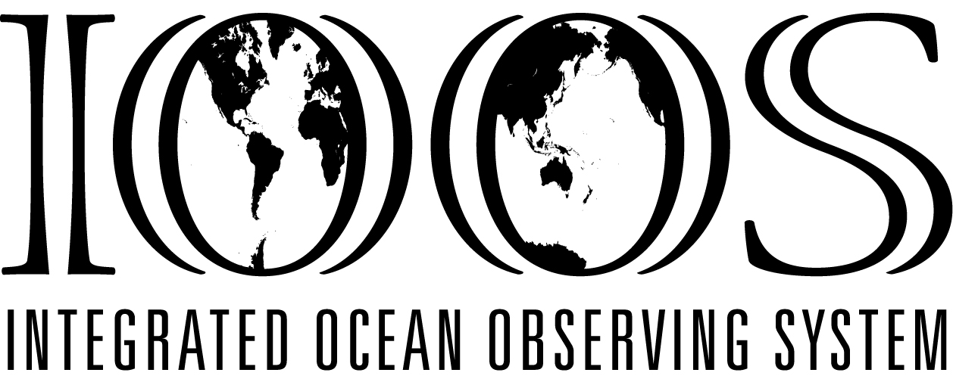
Alaska Ocean Observing System
Molly McCammon
May 23, 2012

Slide 2
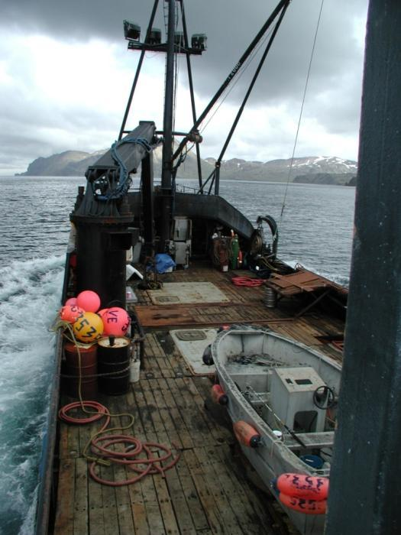
Who is AOOS?
AOOS Mission
Easy access to physical, chemical, and biological data
Network of ocean and coastal observations – if AOOS can’t provide it,
who can? FACILITATION ROLE
Information products and tools for informed decision-making
ALASKA REGIONAL COMMPONENT OFNATIONAL SYSTEM ESTABLISHED BY CONGRESS
Notes:
Partner with other to accomplish these goals.
Make data accessible to anyone with an internet connection

Slide 4
AOOS Founding Board Members
State
Fish and Game
Environ Conservation * vice-chair
Natural Resources
Research
Univ of AK
Sea Grant
AK SeaLife Center * ex-officio EXCOM
Prince William Sound Science Center/
Oil Spill Recovery Inst.
US Arctic Research Commission
North Pacific Research Board
Barrow Arctic Science Consortium * secretary
NOAA AK Fisheries Science Center
Federal
USGS
NOAA * treasurer
Coast Guard
BOERME (MMS)
Other
Marine Exchange of Alaska * chair

Slide 5
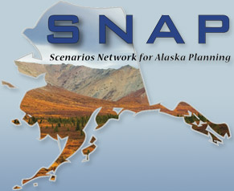
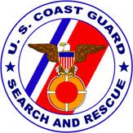
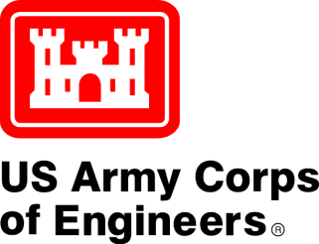

Slide 6
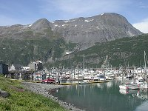
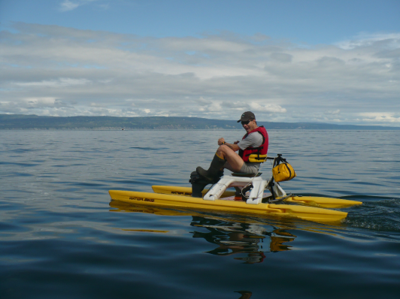
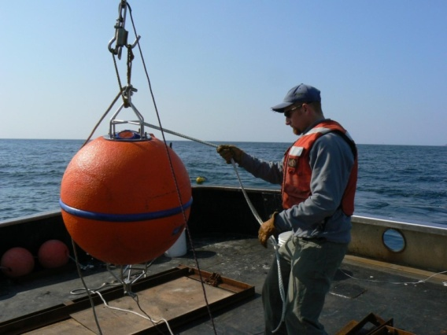
Stakeholder driven
Mariners, fishermen and subsistence users
Search and rescue operations
Scientists
Coastal security operations
Resource managers
Conservation
Industry
Educators
Local communities
Notes:
Whose needs is AOOS trying to meet?
Well, it’s pretty broad.

Slide 7
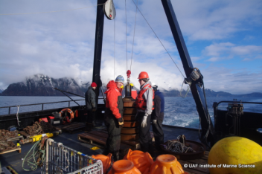
Projects & Programs
What We fund – (examples):
Marine Operations
Circulation and wind modeling, providing daily forecasts in Gulf of AK
Wave modeling (SWAN)
Wave buoys in Cook Inlet & Bering Sea
Snotel stations in Prince William Sound & CI
AIS & weather sites
Coastal Hazards
Alaska Harbor Observation Network – Kodiak &
Seward
Sea Ice Atlas
Water quality
Ocean acidification sensors
Sea Ice Atlas
Ecosystems, Fisheries & Climate Trends
Seward Line (long-term data series)
Glider for Arctic research
Distributed Biological Observatory
HF radars in Chukchi

Slide 8
10 year AOOS build out: draft plan
4 themes:
- Marine operations
Coastal Hazards
Ecosystems/fisheries
Water quality
1 overarching theme:
- Climate variability & trends
3 Large Marine Ecosystems
7 Sub-regions
15 (or more) Areas

Slide 9
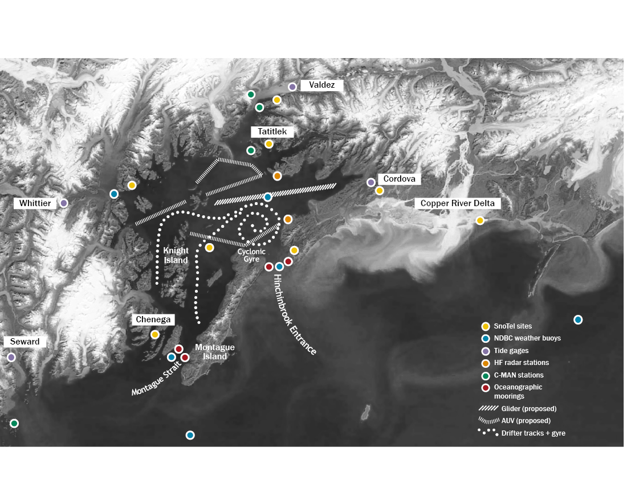
Lessons from the Prince William Sound Demonstration
Notes:
The second major program is a demonstration in Prince William Sound of what a comprehensive ocean observing system might look like in Alaska. For four years now, AOOS has been funding the development of atmospheric, ocean circulation, wave, and biological models for the Sound – all to help better predict search and rescue, oil spill response , and larval transport trajectories. This summer, during a 2-week period, AOOS will be in the sound with drifters, a glider, an AUV, shore-based radar stations, and boat surveys to test the new model forecasts.
AOOS hopes to expand this system to Cook Inlet and Kodiak next. We don’t anticipate being able to do something this comprehensive for the entire Alaska coastline. But we do hope to be able to have something like this in key hotspots in the state, such as the Bering Strait region.

Slide 11
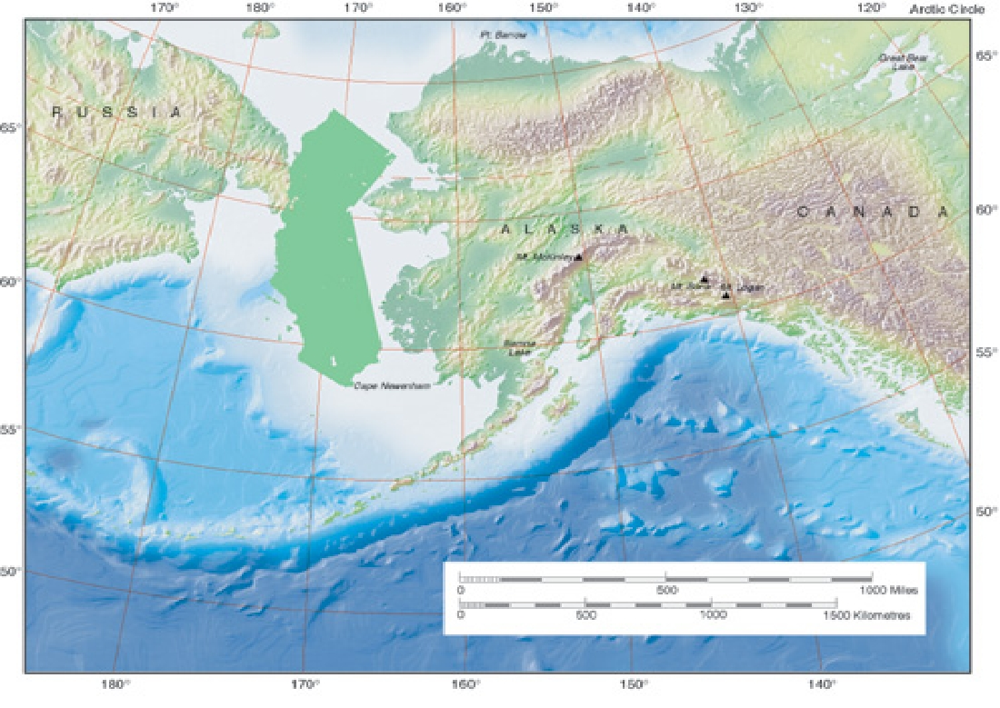
Arctic
Prince William Sound Pilot Project
~300 km
Bering/Aleutian
Gulf of Alaska
Notes:
Introduce the AOOS implementation plan (e.g. many domains nested in three large regions) and the PWS demonstration project (in one domain with specific user needs not necessarily representative of the needs of other domains).
On many maps of the U.S., Alaska and Hawaii are shown at about the same size in an inset off the coast of California. Here we show California off the coast of Alaska at true scale.

Slide 12
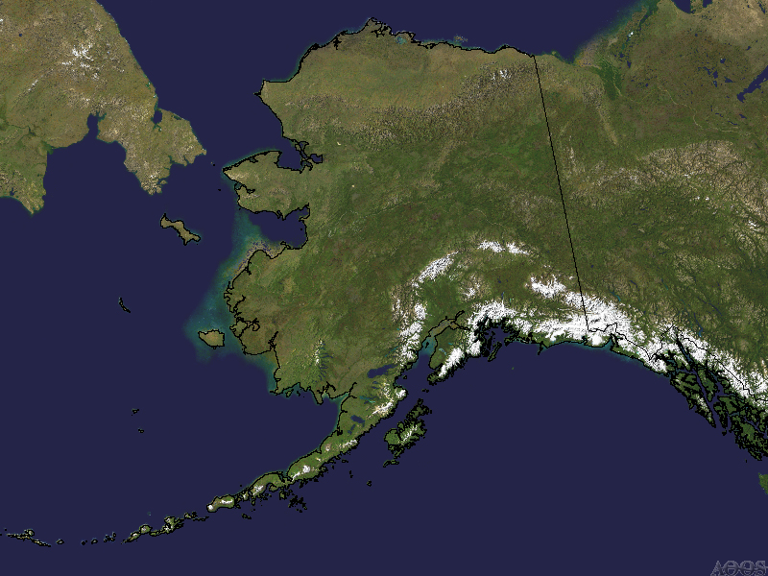
Subregional scale
Coarse resolution everywhere
Rely more on remote sensing, models & regional syntheses
Few observations

Slide 13
Area scale
More point observations
Sentinel monitoring
Finer scale models & forecasts
Add Shorezone detail
GIS data layers

Slide 14
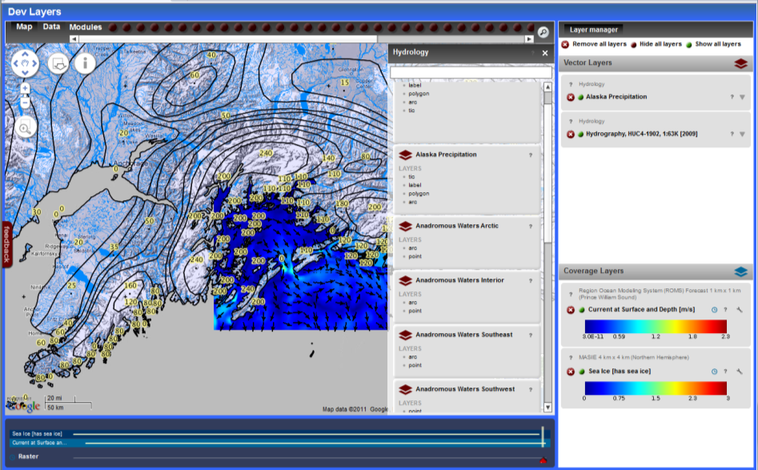
AOOS Ocean Portal
Linking AOOS data applications
View multiple types of
data on one interface
Sensors
Models
Remote Sensing
GIS & project data
In-situ observations
View available time
ranges for each layer
Download data sets
simultaneously
Follow links to data sources
Data management for integrated research projects
Coastal marine spatial planning tools
Public access to industry data
Notes:
This system will allow users to visualize, query and integrate data from multiple source types (sensors, models, remote sensing, GIS data layers and in situ observations) on a single platform.
→planning and management

Slide 15
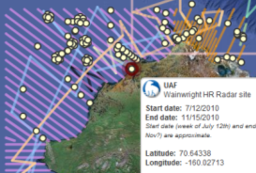
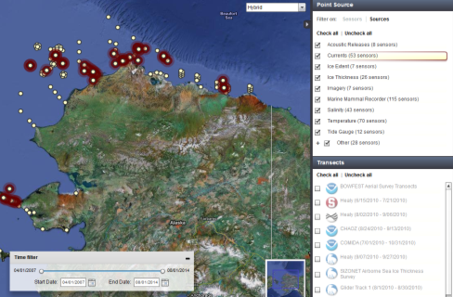
Arctic Research Assets Map
Used for research planning
Reduce duplication of effort
Identify gaps
Avoid collisions
Opportunities for collaboration
Holistic view of research effort
Now expanding to western AK and then statewide

Slide 16
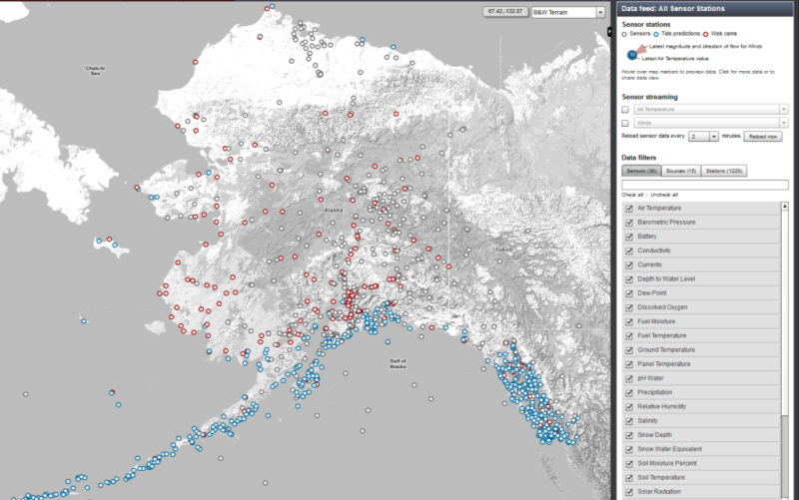
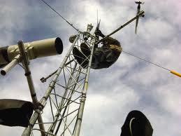
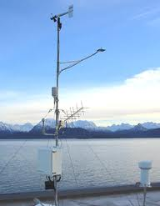
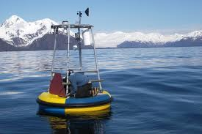
Real-Time Sensor Map
Over 3,000 sensors
Air temp
Barometric Pressure
Currents
Water level
Ground temp
Precipitation
Humidity
Salinity
Snow depth
Stream flow
Stream height
Tides
Water temp
Web cams
Weather
Wind
More….
Notes:
Pulling 3,000+ real-time sensors
Broadest interpretation of “coastal”
Google interface
Zoom in on the Homer area

Slide 17
Winds

Slide 18
Water temp
Tidal Predictions

Slide 19
Webcams
Notes:
Red dots show where webcams are located

Slide 20
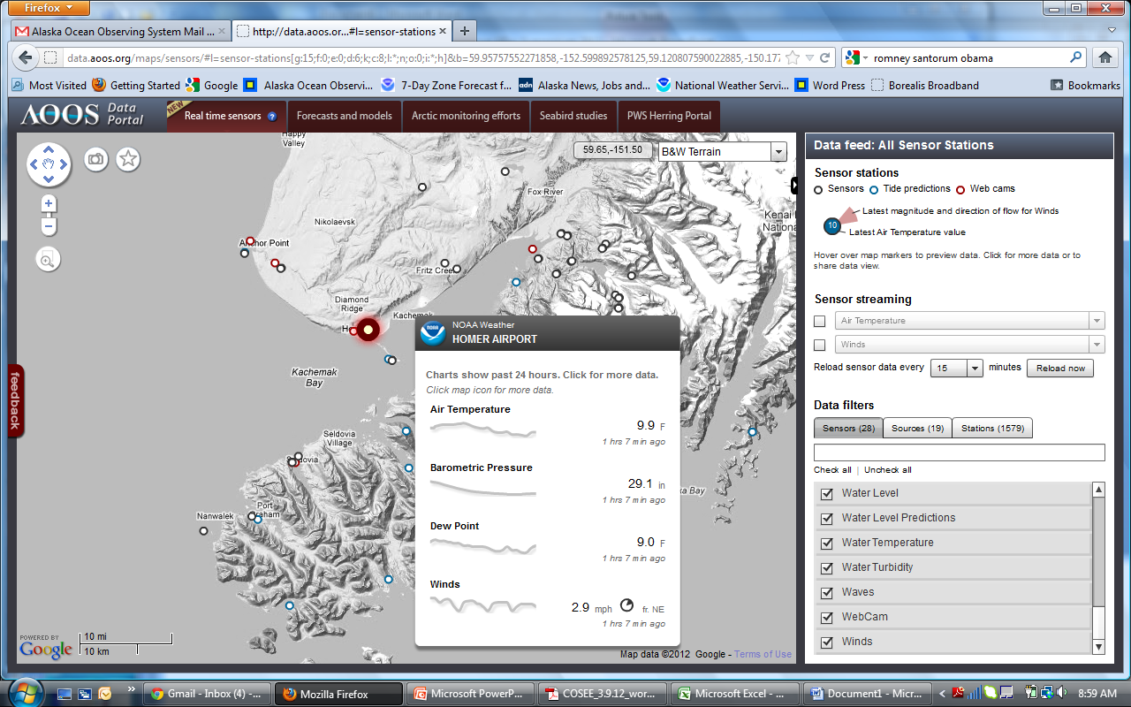

Slide 21
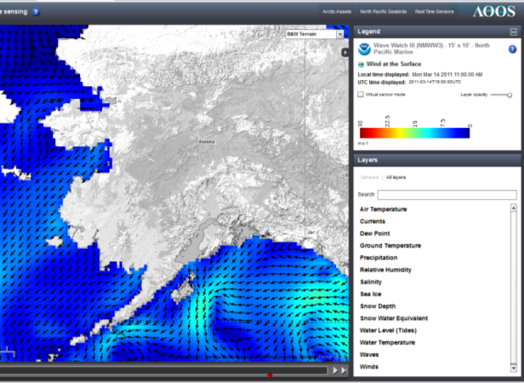
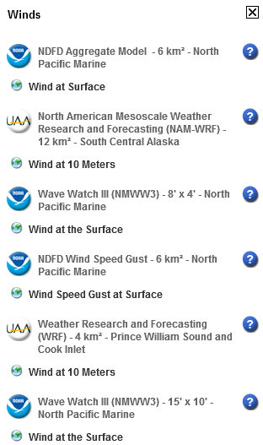
Model Explorer
Useful Parameters
Air Temp
Currents
Dew point
Ground Temp
Precipitation
Relative Humidity
Salinity
Sea Ice
Snow Depth
Snow Water Equivalent
Water Level (tides)
Water Temperature
Waves
Wind
Notes:
Have list of models

Slide 22
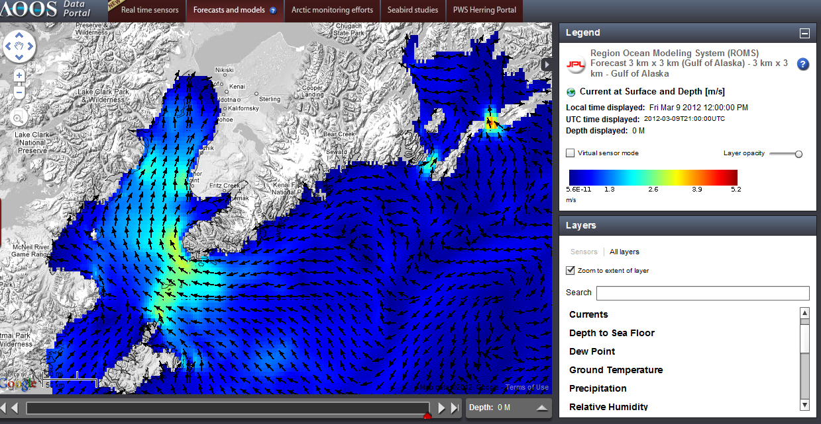
Currents
4 hrs into the future
Notes:
Have list of models

Slide 23
Currents
Drop your own virtual sensor
Notes:
Have list of models

Slide 24
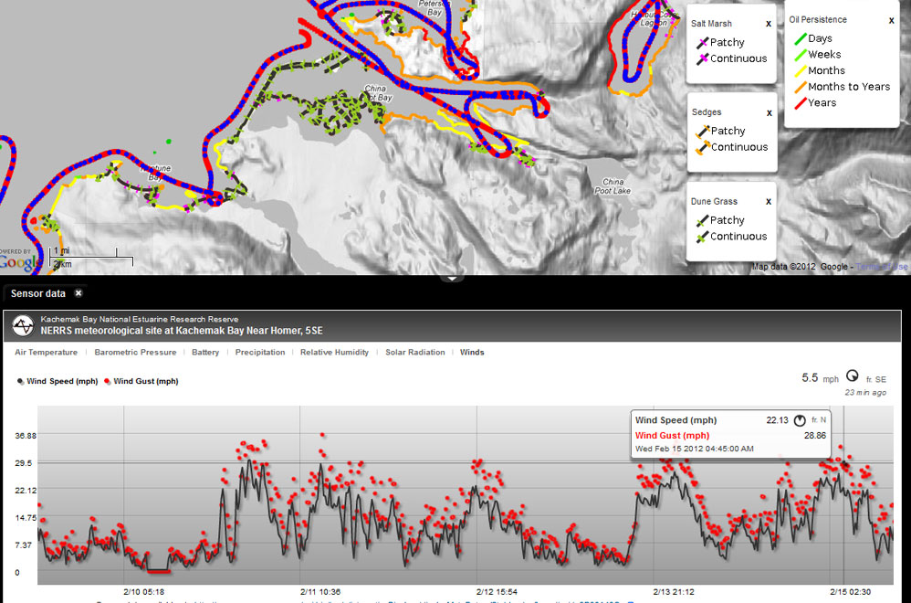
Cook Inlet Response Tool

Slide 25
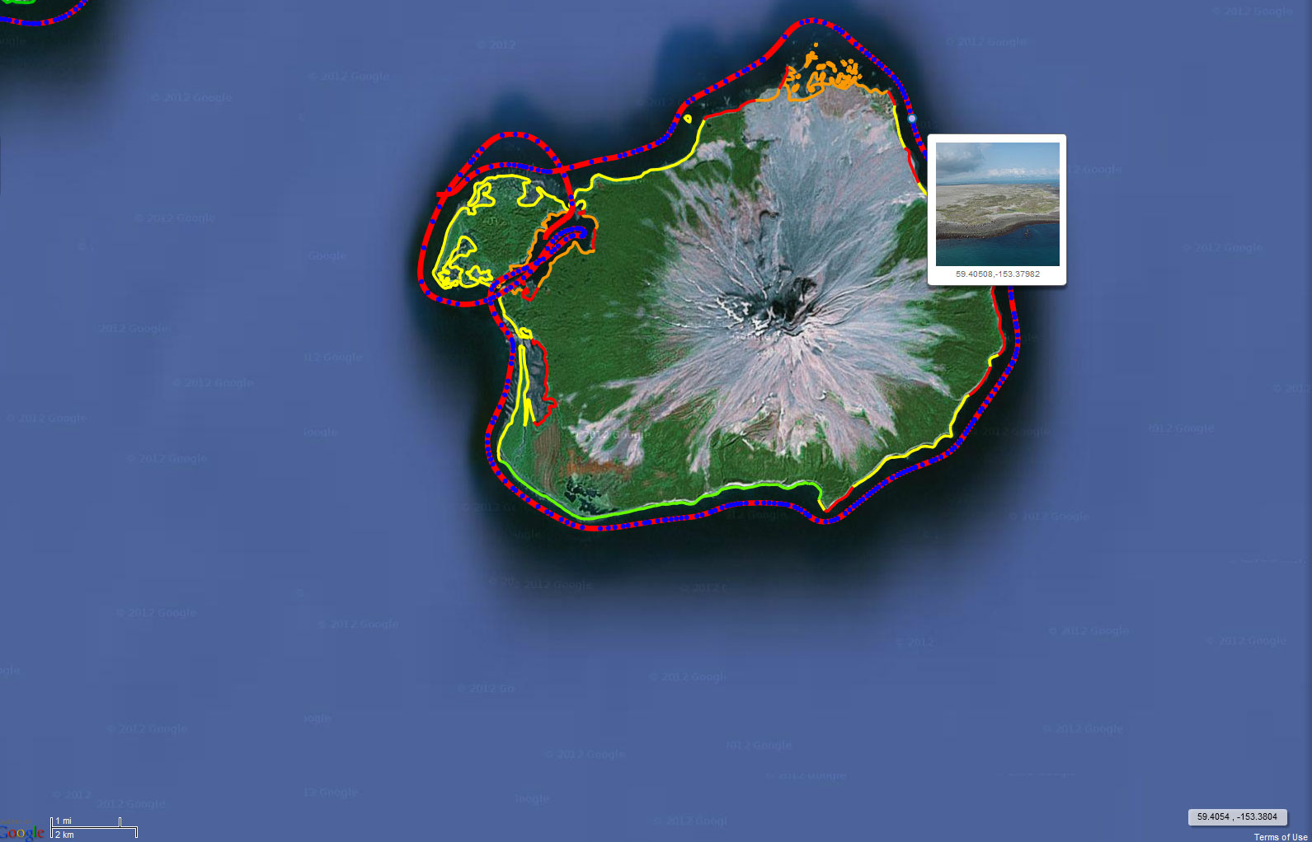
Cook Inlet Response Tool

Slide 26
Industry/NOAA Data Sharing MOA
Signed in August by NOAA & 3 companies: Shell, Statoil & ConocoPhillips
Umbrella agreement committing industry to sharing data with government and public
1st priority: Annex #1, met ocean data in real-time to assist weather forecasting & sea ice images for forecasting – now signed
2nd priority: Annex #2, historic met-ocean data and non-real time environmental studies data
3rd priority: Annex #3, hydrographic & bathymetry surveys for charting, habitat mapping
AOOS Data Portal: public access to industry data
NOAA data centers: archives and access

Slide 27
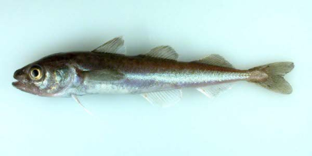
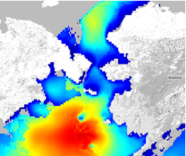
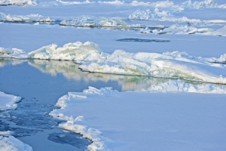
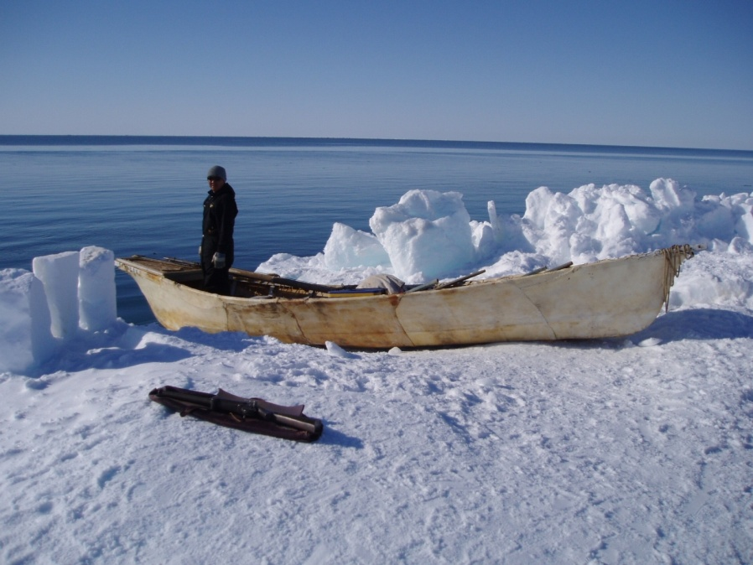
STAMP Project Spatial Tools for Arctic Mapping & Planning
State concerns w/CMSP, but strong support for data integration
Focus on identifying needs forl data layers for decision support: human uses,
20 year climate scenarios, environmental (physical, biological, chemical)
What info do stakeholders need to plan for
potential commercial fisheries in Arctic?
What tools do decision-
makers need?
1.5 year, $760k
Partners: AOOS, UA, TNC

Slide 28
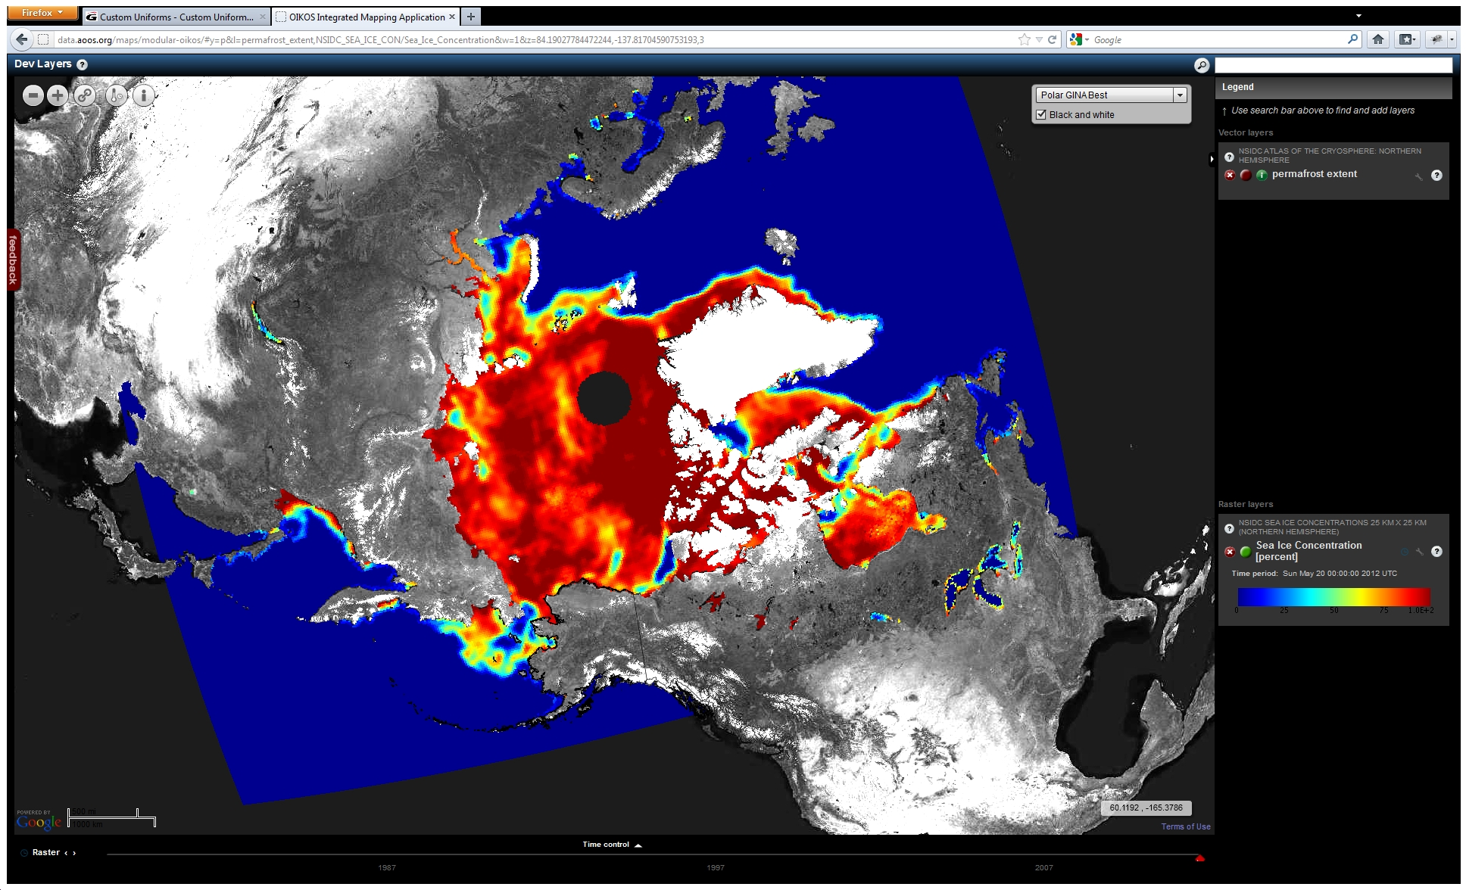
STAMP: Sea Ice Concentration (Daily Snapshot 1978-Current)
D

Slide 29
Conclusions
AOOS stakeholders depend greatly on hydrographic services for multiple needs - & not just navigation
(ADF&G: run timing of salmon into Y-K rivers)
AOOS has very broad mission & mandate – diverse stakeholders: measure once, use many times for multiple purposes
AOOS can often provide obs, forecasts & facilitation services that are cheaper, flexible, faster, innovative
AOOS serves as key data assembly center & integrator: Ocean in 4-D to meet broad range of needs
AOOS is regional system that feeds into national & global networks
Lots of interest now in Arctic: changing landscape of players

Slide 30
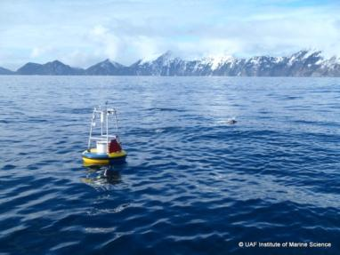
Thanks
www.aoos.org
Acknowledgements:
Axiom Consulting & Design, and many, many other partners on the federal, state, regional, and local level
Notes:
AOOS is a network of partners

